Slide 1
Tell me,
what do you want?

Slide 2





What’s going on in the IT jungle
Requirements
Analysis
Acceptance
Testing
Make a right product!
Make the product right!
High Level
Design
System
Testing
Detailed
Design
Integration
Testing
Implementation
Unit Testing

Slide 3
What if customer’s requirements are misunderstood?
Validation
Requirements
Analysis
Make a right product!
Make the product right!
Acceptance
Testing
High Level
Design
System
Testing
Detailed
Design
Integration
Testing
Implementation
Unit Testing

Slide 4


Improve S/W development model
v.s.
Waterfall

Slide 5


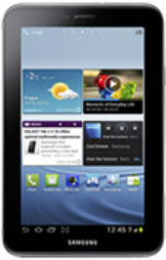
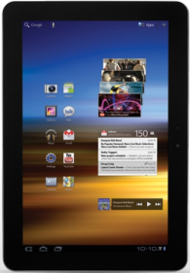
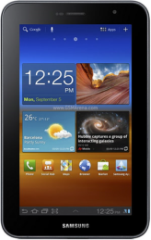
Innovator v.s. Fast Follower
iPad
G
R
O
W
T
H
Galaxy
Tab2
A
Galaxy
Tab 10.1
S
Innovator
Galaxy
Tab 7.0
2012
Fast Follower
2011
2010
TIME

Slide 6

IT jungle ecosystem (KR v.s. AU)
Low
High
High
AU
Middle
KR
Middle
LOW

Slide 7
Finding various customer’s voice
Stakeholders
Other
Stakeholders
Customers
Favored
Users
Disfavored
Users
Ignored
Users
Other Users

Slide 8
What if they do not tell what they want?
Find User
Watch User
Analyze User
Understand User

Slide 9
Any Questions?

Slide 10
Next! Coming soon!
Requirements
Analysis
Make a right product!
Make the product right!
Acceptance
Testing
High Level
Design
System
Testing
V-Model
Detailed
Design
Integration
Testing
Implementation
Unit Testing

Slide 11
Thank You!

Slide 12
Find User
SPTM support App
Goal: Let’s boost SPTM with members’ active participation!
Members
Paid Members
Guests
Officers
Common Members
President
VP
Education
VP
Membership
VP PR
Secretary & Treasury
S.A.A

Slide 13
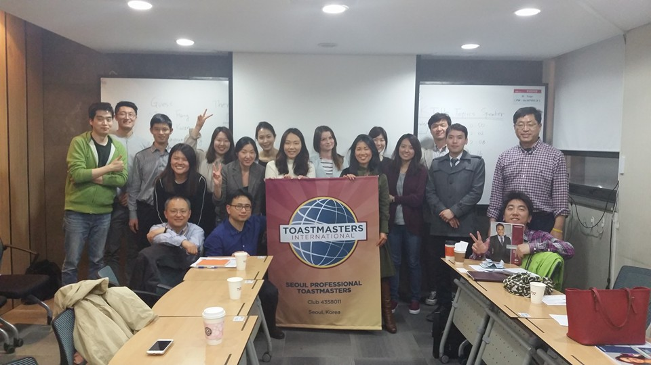
Watch User
Proficient
English Competence
elementary
Extroverted
Personality
Introverted
High
Attendance Rate
Middle
Low

Slide 14
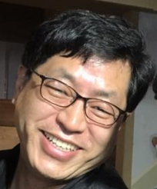

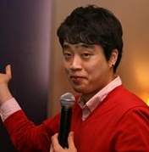

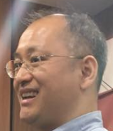

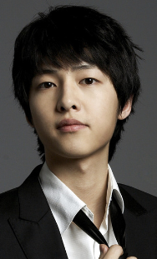
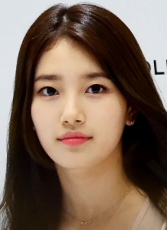
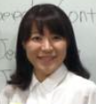
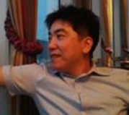
Analyze User
Persona 1
- Proficient
- Extroverted
- High attendance rate
Persona 2
- Proficient
- Extroverted
- Middle attendance rate
Persona 3
- Proficient
- Extroverted
- Low attendance rate
Persona 4
- Elementary
- Introverted
- High/Middle attendance rate

Slide 15
Analyze User
Finding high priority persona!
Persona 1
- Proficient
- Extroverted
- High attendance rate
Persona 2
- Proficient
- Extroverted
- Middle attendance rate
Persona 3
- Proficient
- Extroverted
- Low attendance rate
Persona 4
- Elementary
- Introverted
- High/Middle attendance rate

Slide 16

Understand User
Item | Content
Basic Information | - Name: Suzy - Age: 23 - Attendance rate: Middle - English Competence: Elementary - Personality: Introverted - Role: Hardly occupied
SPTM Activity | - Registration day: 01/03/2016 - State: Paid member
Scenario
Customer’s potential
requirement
I want to register for any role at my convenience.

